Slide 1
FOX HOLLOW
KINDERGARTEN ORIENTATION
2025-2026

Slide 2
Welcome to Fox Hollow
School Website: https://foxhollow.jordandistrict.org/
School Phone Number: (801) 282-1818
Hours:
– AM: 9:00am to 11:40am M-TH, 9:00 – 10:55 am F
– PM: 12:55pm to 3:35pm M-TH, 11:05 am – 1:00 pm F

Slide 3
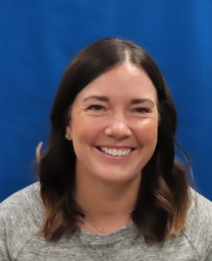
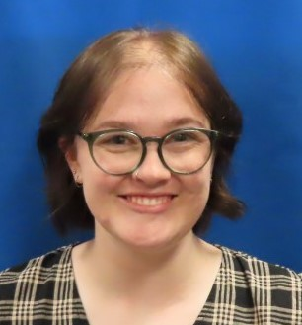
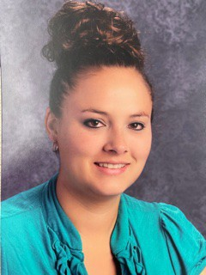
Meet the Teachers
Mrs. Clements
PM
Miss Harms
Full - day
Mrs. Knudsen AM
Mrs. Clegg
Full-day
*We do not know how many sessions we will have next year.*

Slide 4
Drop-off and Pick-up
PLEASE, PLEASE, PLEASE always follow parking lot procedures. This is for everyone’s safety!
The drop off lane is to drop student’s off. The parking lot, pull through lane is NOT.
When in the drop off lane, please pull all of the forward, up to the curb and stop before allowing children to exit or enter the vehicle on the right side of the vehicle.
Keep traffic moving as quickly as possible.
If your student needs extra assistance, please park your car and walk your student across the crosswalk.

Slide 5
Parent Pick Up
Teachers will have student’s wait inside the Kindergarten fence until they see who is picking them up. Please be patient as we have many students to get out of the gate.
We will NOT send students home with other people unless we have a note or phone call from the parents. An email has to be sent the night before.

Slide 6
Buses
If students ride the school bus or a daycare bus they will be put on the bus at the end of school by a teacher all year long.
For the first week of school, a teacher will be waiting at the bus stop to help teach them how to walk to the Kindergarten doors.
We will ALWAYS send students home on the bus or daycare unless we get a note or call from you. An email must be sent the night before.

Slide 7
First Day of School
Drop off students outside of gate.
Please say good-bye & give hugs before they enter the fence.
Make sure teacher knows how students get home the first day. If they take the bus or daycare, please try to start that from the beginning.
No playing on play ground in the morning because there are so many students, Please have them come in the gate and line up with their class.

Slide 8
Questions?
If you have any questions, please call the school at (801) 282-1818.

